Slide 1
Generative Models & Determining Trained
Presenter: Kim Seung Hwan (overnap@khu.ac.kr)

Slide 2
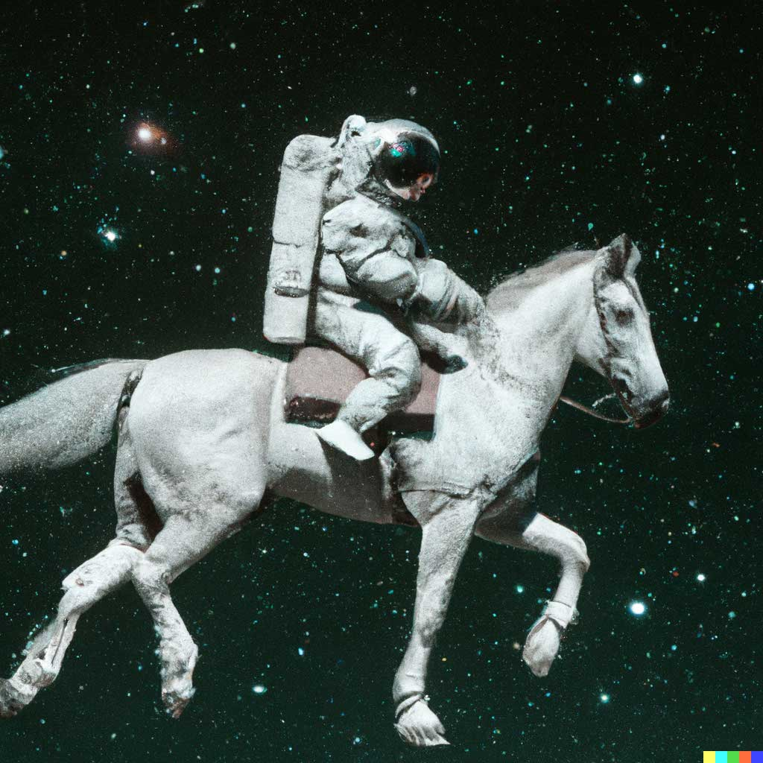
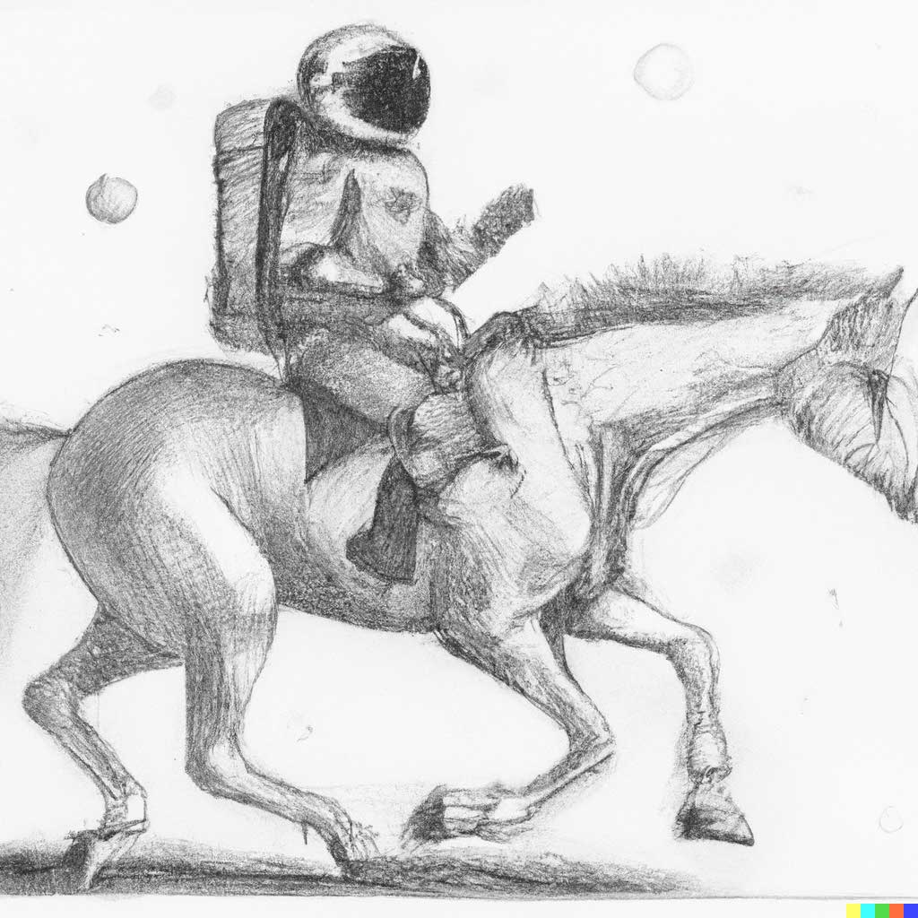
“An astronaut riding a horse in a photorealistic style”
“An astronaut riding a horse as a pencil drawing”
OpenAI DALL-E 2

Slide 3
Goal
Determining if a model has trained on some data
This is important in two ways as DNNs are becoming commercialized
Copyright aspect; even more important in generative models
Metric aspect; the model’s training efficiency, generalization performance, and the value of new data for it
It seems worth, but is it possible?

Slide 4
Goal
My thoughts:
In supervised learning, a model is forced to represent training data
The model is optimized for the training data, not the true distribution
The ideal generalization is difficult to achieve empirically
It will be able to determine under appropriate constraints (but so what?)

Slide 5
Progress
Studying generative models, especially VAE and Diffusion Model
Naïve experiments and analysis attempts on simplified problem

Slide 6
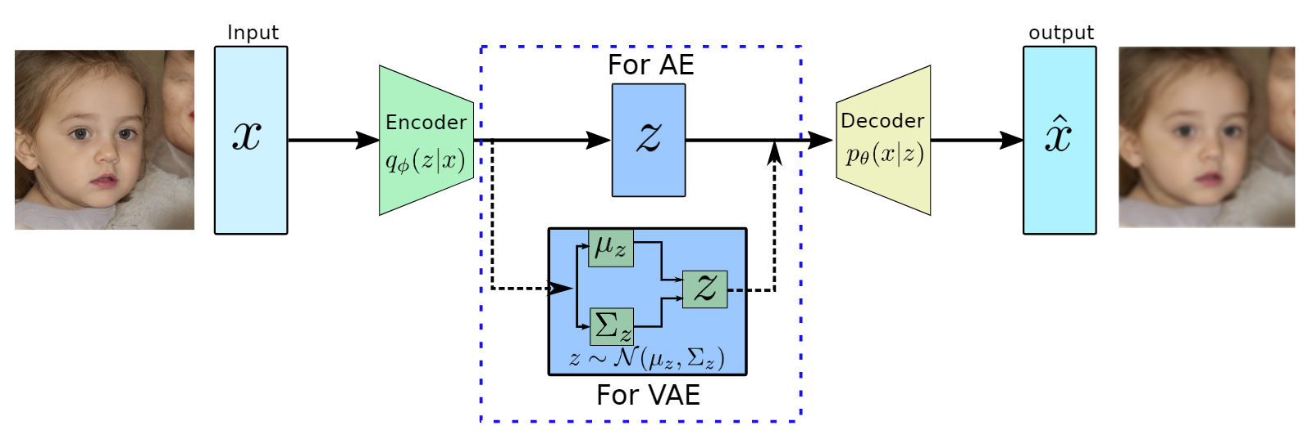
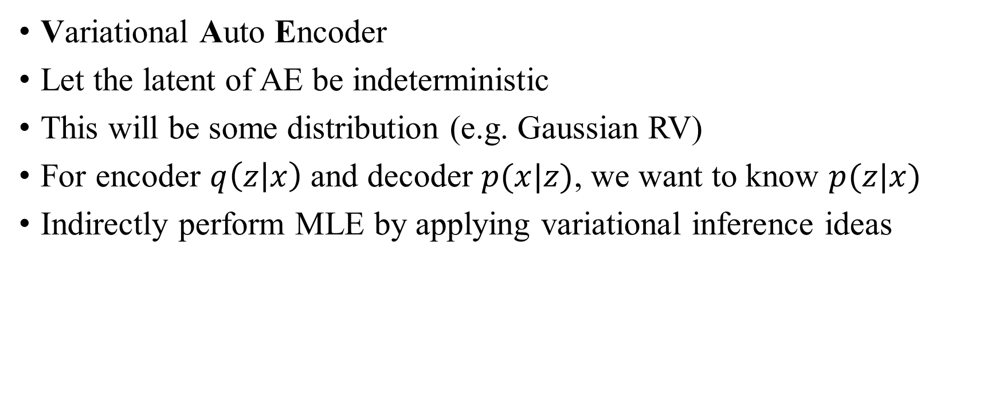
VAE
Variational Auto Encoder
Let the latent of AE be indeterministic
This will be some distribution (e.g. Gaussian RV)
For encoder $q\left(z | x\right)$ and decoder $p(x|z)$, we want to know $p(z|x)$
Indirectly perform MLE by applying variational inference ideas

Slide 7
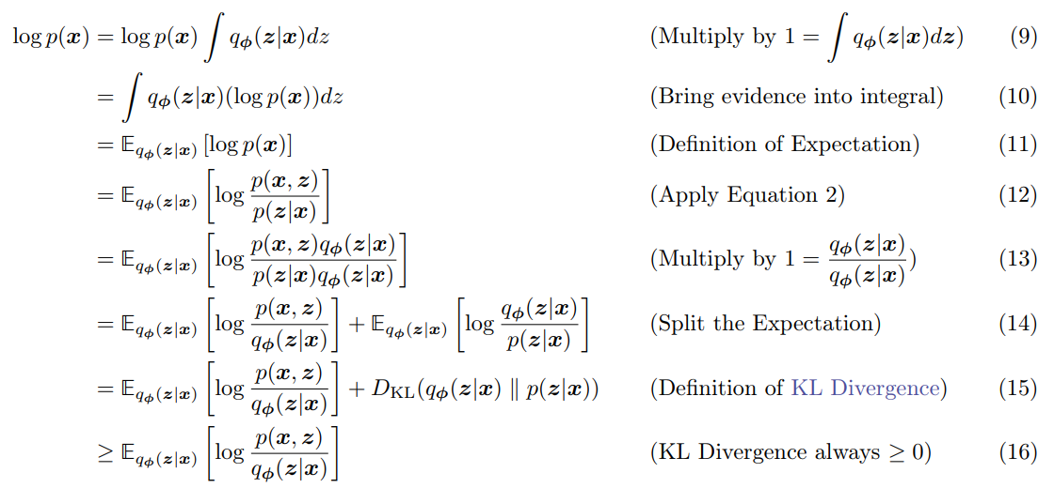
VAE
ELBO

Slide 8
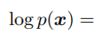
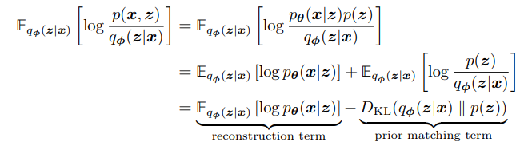
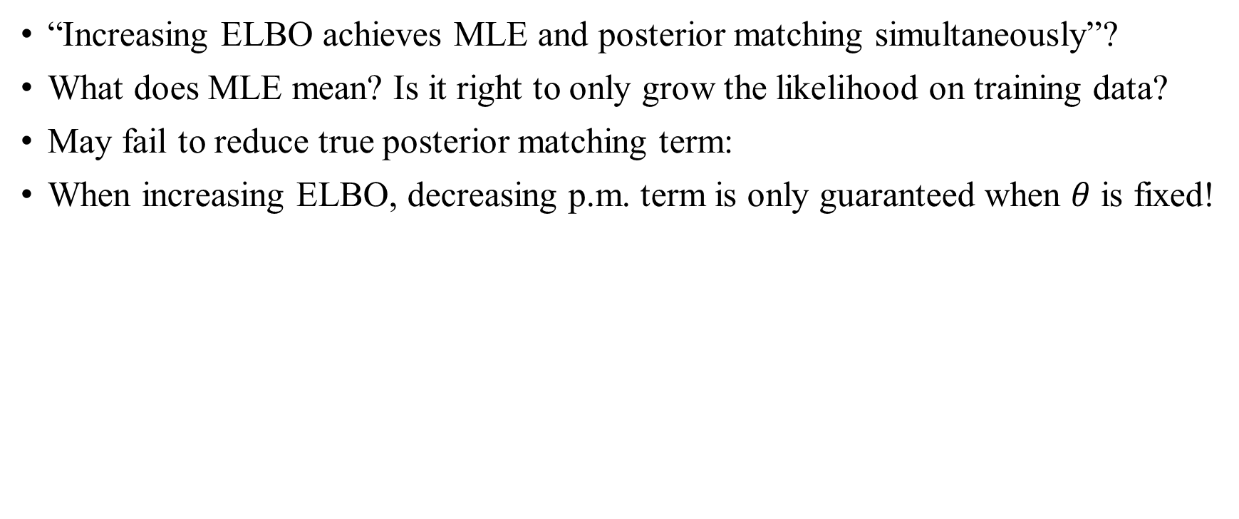
VAE
“Increasing ELBO achieves MLE and posterior matching simultaneously”?
What does MLE mean? Is it right to only grow the likelihood on training data?
May fail to reduce true posterior matching term:
When increasing ELBO, decreasing p.m. term is only guaranteed when $θ$ is fixed!
true posterior matching term
ELBO

Slide 9
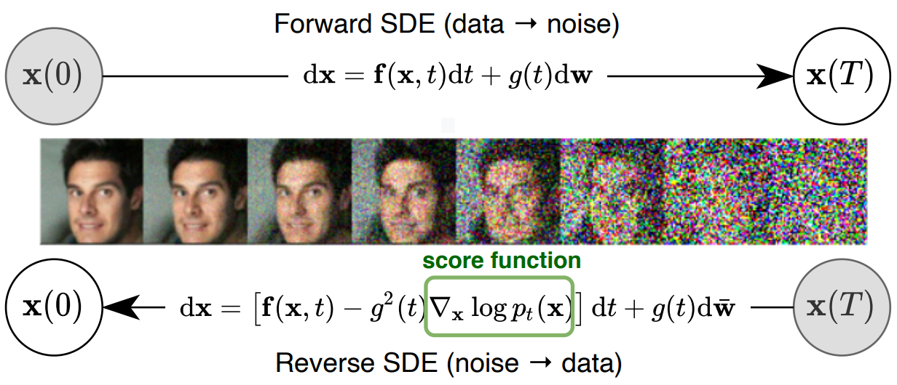
Diffusion Model
Adding small Gaussians to a sample to make it a full Gaussian
It requires a lot of steps

Slide 10

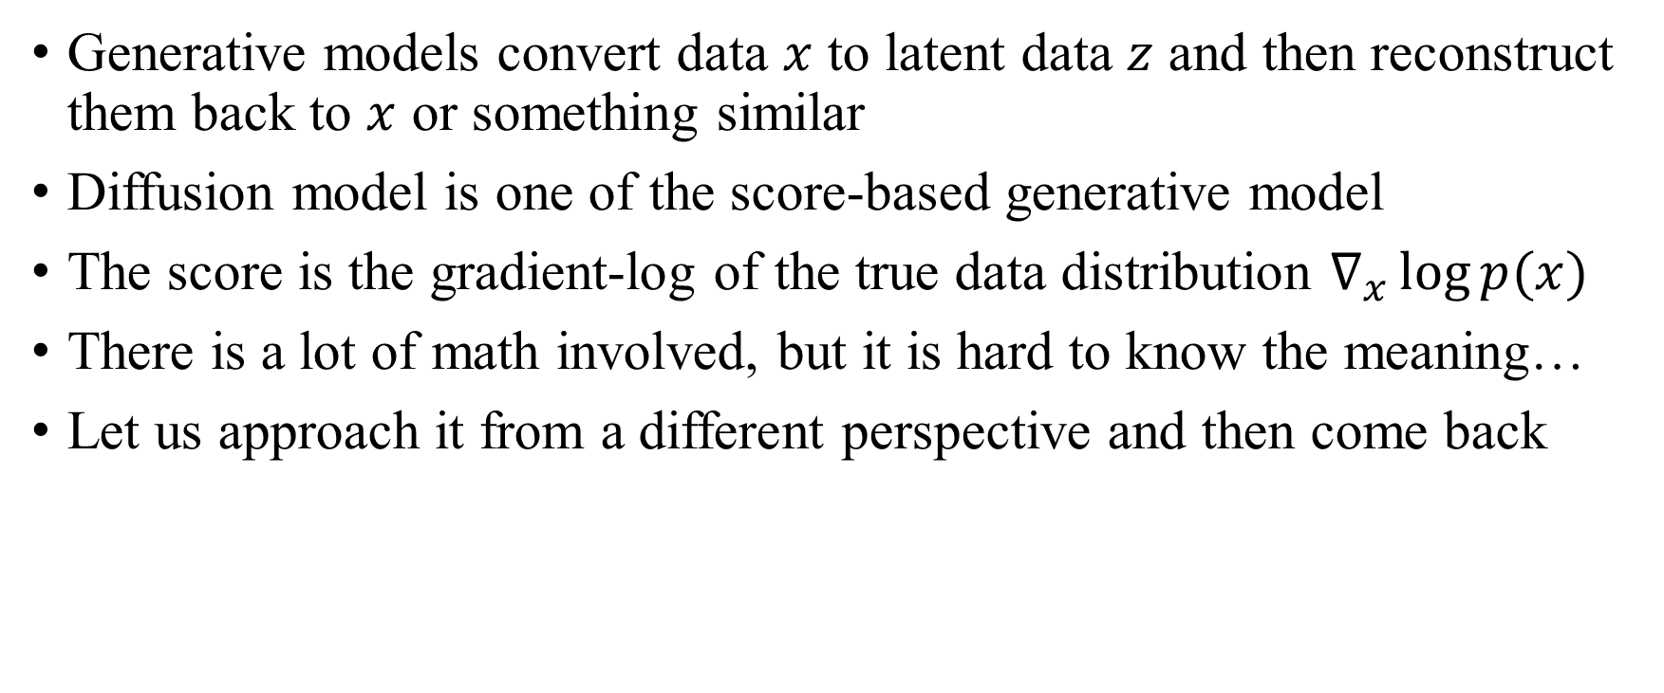
Diffusion Model
Generative models convert data $x$ to latent data $z$ and then reconstruct them back to $x$ or something similar
Diffusion model is one of the score-based generative model
The score is the gradient-log of the true data distribution $∇_{x}\log{p(x) }$
There is a lot of math involved, but it is hard to know the meaning…
Let us approach it from a different perspective and then come back

Slide 11
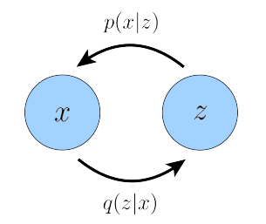
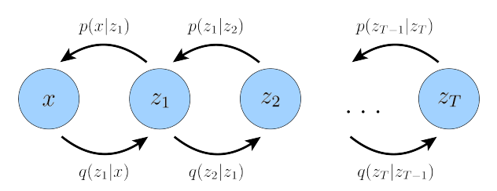
Diffusion Model
A hierarchical structure in which several VAEs are connected
This is called HVAE and is a generalization of VAE
Like DNNs, HVAEs are likely to have more representation ability
VAE
(Markovian) HVAE

Slide 12
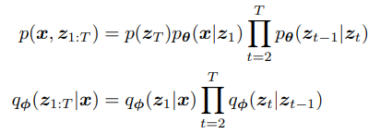
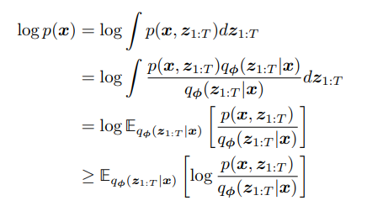

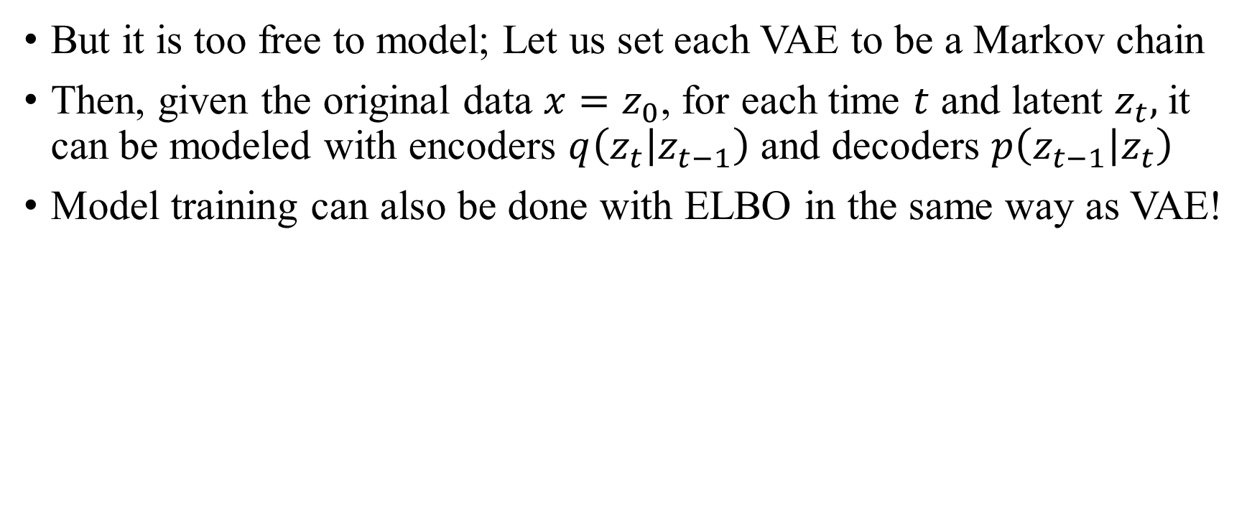

Diffusion Model
But it is too free to model; Let us set each VAE to be a Markov chain
Then, given the original data $x=z_{0}$, for each time $t$ and latent $z_{t},$it can be modeled with encoders $q\left(z_{t} | z_{t−1}\right)$ and decoders $p\left(z_{t−1} | z_{t}\right)$
Model training can also be done with ELBO in the same way as VAE!
‘cause it’s Markov chain!
ELBO

Slide 13
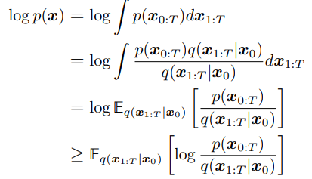
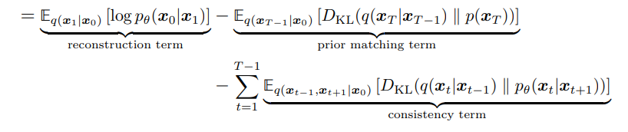
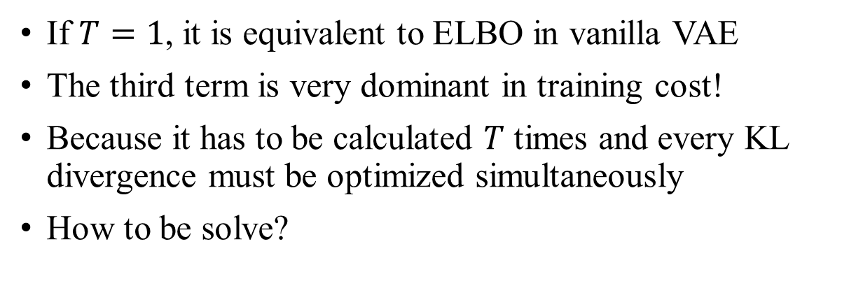
Diffusion Model
If $T=1$, it is equivalent to ELBO in vanilla VAE
The third term is very dominant in training cost!
Because it has to be calculated $T$ times and every KL divergence must be optimized simultaneously
How to be solve?

Slide 14
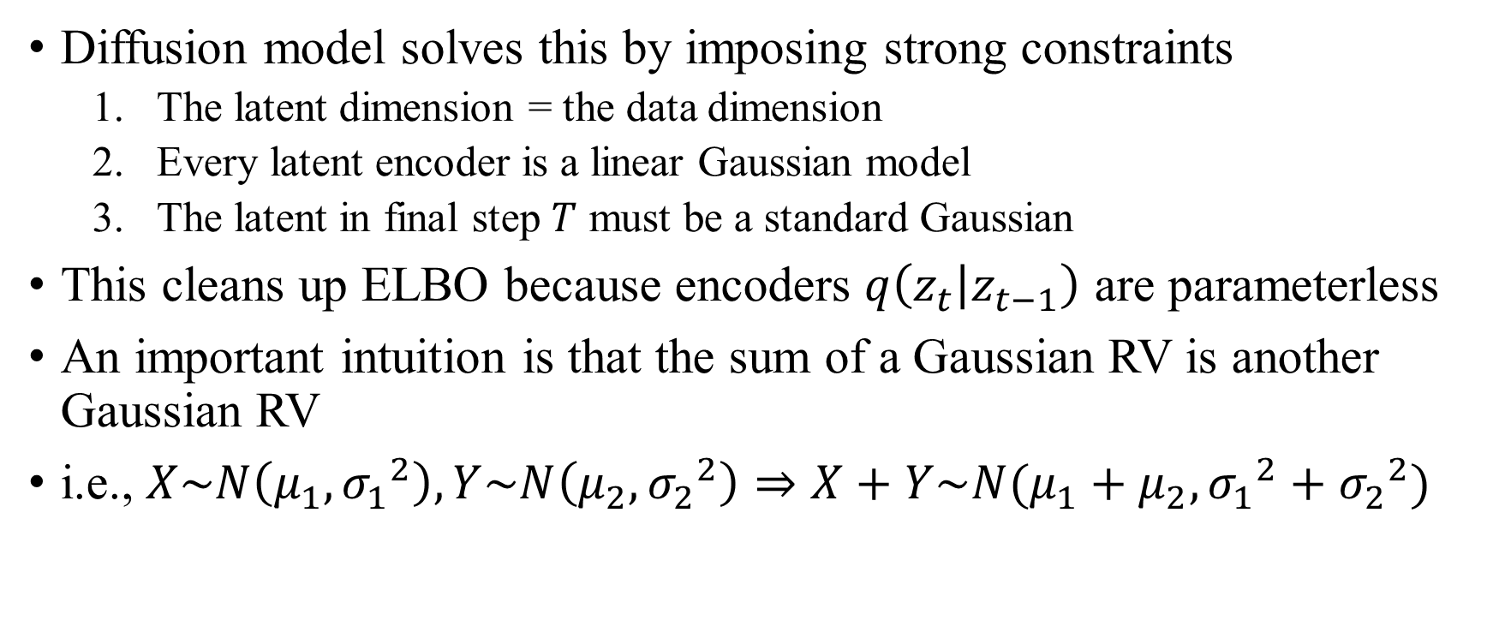
Diffusion Model
Diffusion model solves this by imposing strong constraints
The latent dimension = the data dimension
Every latent encoder is a linear Gaussian model
The latent in final step $T$ must be a standard Gaussian
This cleans up ELBO because encoders $q\left(z_{t} | z_{t−1}\right)$ are parameterless
An important intuition is that the sum of a Gaussian RV is another Gaussian RV
i.e., $X\sim N\left(μ_{1}, {σ_{1}}^{2}\right), Y\sim N\left(μ_{2}, {σ_{2}}^{2}\right)⇒X+Y\sim N(μ_{1}+μ_{2},{σ_{1}}^{2}+{σ_{2}}^{2})$

Slide 15
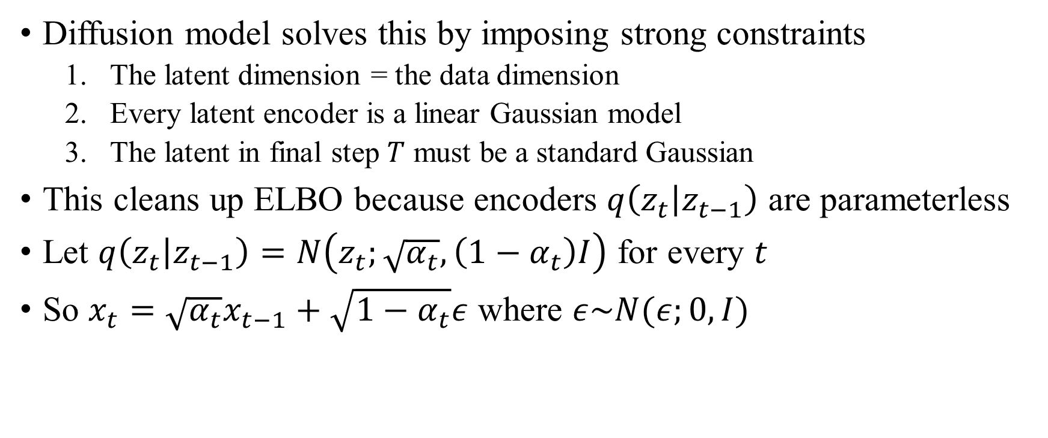
Diffusion Model
Diffusion model solves this by imposing strong constraints
The latent dimension = the data dimension
Every latent encoder is a linear Gaussian model
The latent in final step $T$ must be a standard Gaussian
This cleans up ELBO because encoders $q\left(z_{t} | z_{t−1}\right)$ are parameterless
Let $q\left(z_{t} | z_{t−1}\right)=N\left(z_{t};\sqrt{α_{t}},\left(1−α_{t}\right)I\right)$ for every $t$
So $x_{t}=\sqrt{α_{t}}x_{t−1}+\sqrt{1−α_{t}}ε$ where $ε\sim N(ε;0,I)$

Slide 16
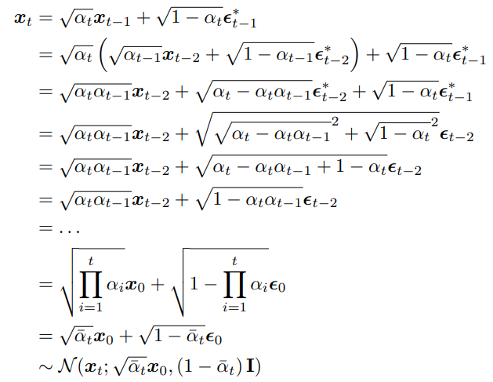
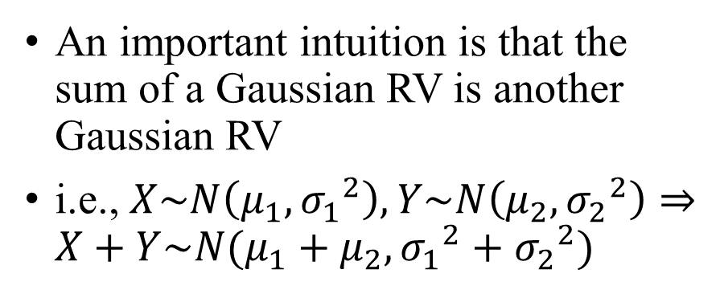
Diffusion Model
An important intuition is that the sum of a Gaussian RV is another Gaussian RV
i.e., $X\sim N\left(μ_{1}, {σ_{1}}^{2}\right), Y\sim N\left(μ_{2}, {σ_{2}}^{2}\right)⇒X+Y\sim N(μ_{1}+μ_{2},{σ_{1}}^{2}+{σ_{2}}^{2})$

Slide 17
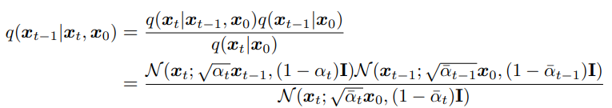
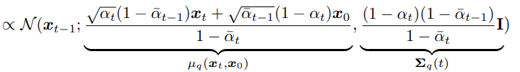

Diffusion Model

Slide 18
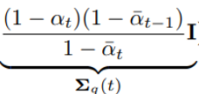
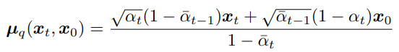
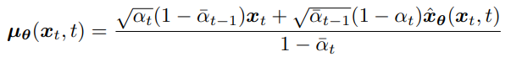
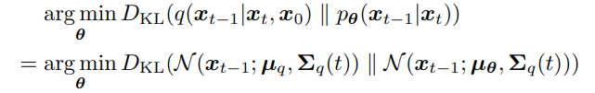
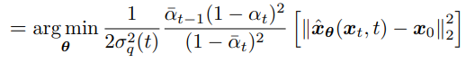
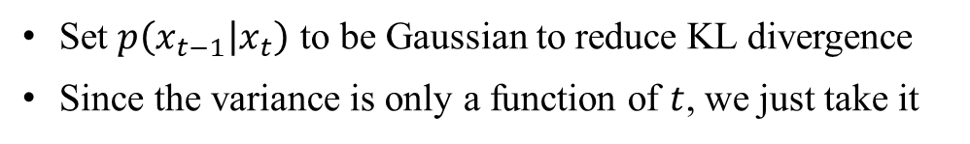

Diffusion Model
Set $p\left(x_{t−1} | x_{t}\right)$ to be Gaussian to reduce KL divergence
Since the variance is only a function of $t$, we just take it

Slide 19
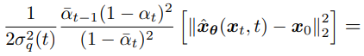
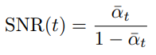
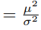
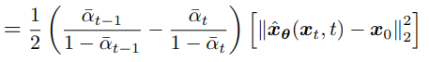
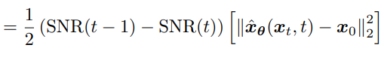
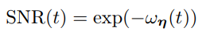
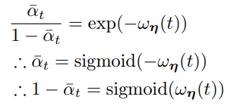
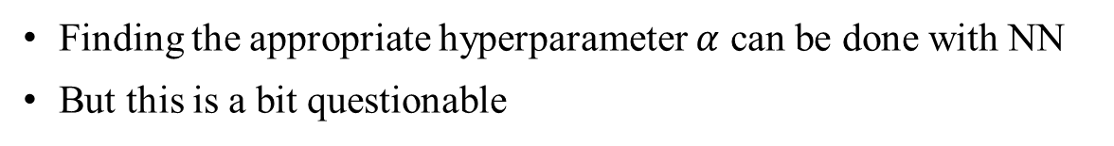

Diffusion Model
Finding the appropriate hyperparameter $α$ can be done with NN
But this is a bit questionable

Slide 20
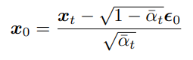
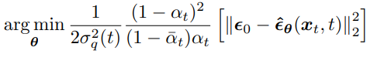
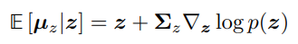
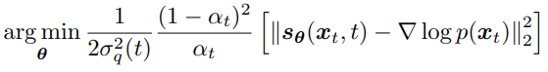
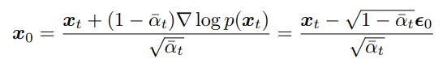
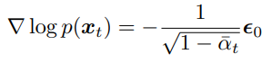
Diffusion Model
Expression manipulation never ends…
We can view the optimization problem of diffusion model in 3 aspects:
Training original data!
Training the noise!
Training the score!
This is the ‘score’!
“commonly used to correct sample bias”
Tweedie’s Formula

Slide 21
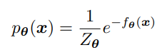
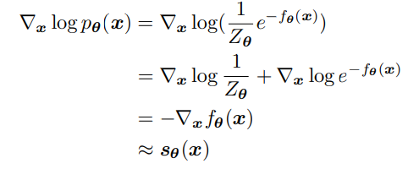
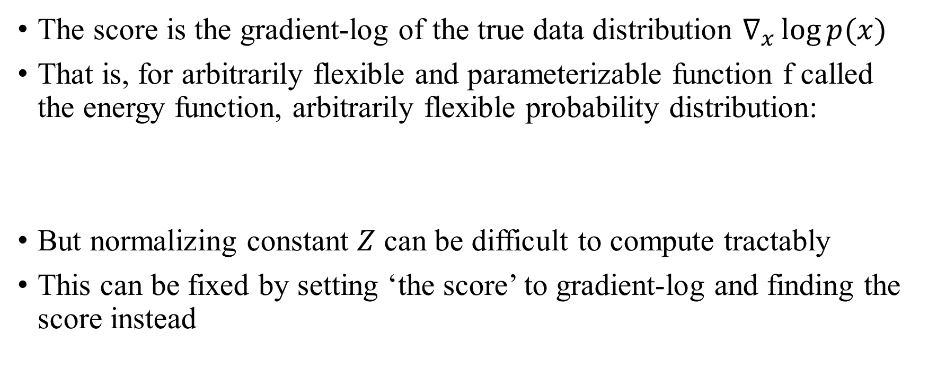
Score-based Generative Model
The score is the gradient-log of the true data distribution $∇_{x}\log{p(x) }$
That is, for arbitrarily flexible and parameterizable function f called the energy function, arbitrarily flexible probability distribution:
But normalizing constant $Z$ can be difficult to compute tractably
This can be fixed by setting ‘the score’ to gradient-log and finding the score instead

Slide 22
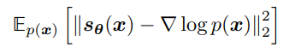
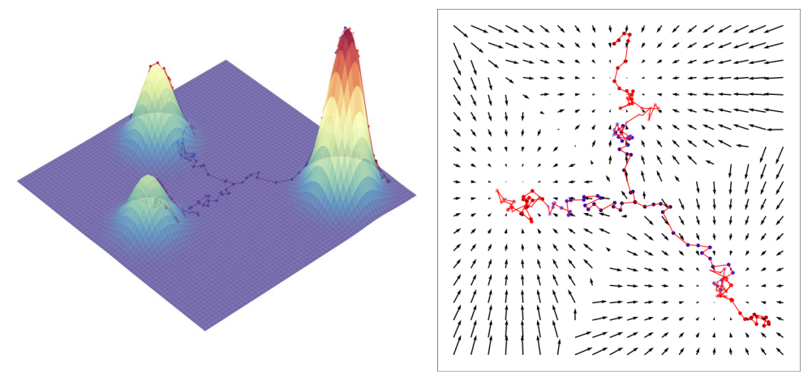
Score-based Generative Model
Express the score as a DNN by optimizing the Fisher Divergence
The score means the direction the log-likelihood increases
The Score-based generative model borrows the idea of Langevin dynamics, a molecular system model that can represent molecular diffusion
…and this is the vanilla score matching

Slide 23
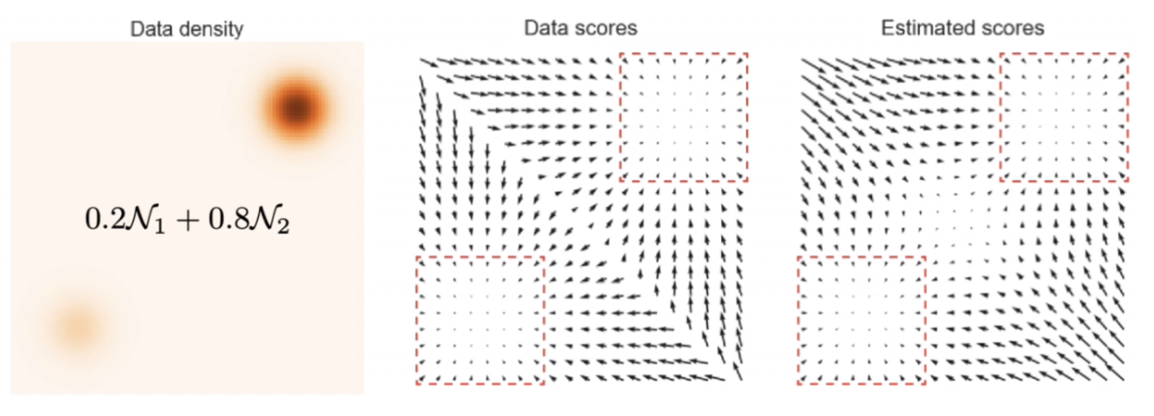

Score-based Generative Model
It can estimate an intractable distribution
But it is very computationally expensive and has various problems:
Ill-defined when $x$ lies on a low-dimensional manifold
Not be accurate in low density regions
Density is not reflected well (e.g., mixture model)

Slide 24

Score-based Generative Model
This can be handled by adding Gaussians of different strengths
The problem of computational cost is solved by estimating the scores of distributions made from noising samples
Since Gaussian is defined in all spaces, it solves many problems
Ill-defined when $x$ lies on a low-dimensional manifold OK
Not be accurate in low density regions somewhat ok
Density is not reflected well (e.g., mixture model) ???

Slide 25


Diffusion Model
Therefore, if we optimize all the Fisher Divergence at each noise level,
A similar expression emerges when solved from the HVAE perspective
Furthermore, if we modify Langevin dynamics sampling in terms of simulated annealing:
Initialize from some fixed prior (e.g., uniform, gaussian)
Running Langevin dynamics for each $t=T, T−1, T−2…$
The starting point of each step is the ending point of the previous one
It can be perfectly modeled as a Markovian HVAE!

Slide 26
Diffusion Model
In conclusion, the diffusion model can be interpreted as an
Hierarchical VAE with strong constraints to deal with the computational cost
Denoising score-based generative model with a clear, comprehensive explanation and great performance
These are not separate but complementary to each other
Approaching from different perspectives always gives good ideas!
I hope this helped you get a rough understanding

Slide 27
Diffusion Model
Diffusion models still have very important topics like SDE, but these are not fully understood. (too HARD for me!!!)
Simple to understand, it seems to be an explanation that unifies the continuous Langevin dynamics process and the discrete DNN process
The guidance (conditional one) is also possible (e.g., Image-Text)
However, there are many other stories about these…
For more details on this presentation, SDE, etc., see below:
Luo et al. “Understanding Diffusion Models: A Unified Perspective” [2208.11970]
Song et al. “Generative Modeling by Estimating Gradients of the Data Distribution” [1907.05600] (NCSN)
Ho et al. “Denoising Diffusion Probabilistic Models” [2006.11239] (DDPM)

Slide 28



Experiments and Analysis
This is one of the results of the experiment in the last presentation
Simplifying the situation as a classification problem, let us determine whether the model has learned from that data
Are there any significance features that only trained data have?
Looking at the picture on the right
Can we say that the data has been trained?
The trained data (I thought it’s significant)
A model’s output
A plane in the data space (no dimensionality reduction!)

Slide 29

Experiments and Analysis
At first glance, it seems trained (or maybe not)
Can we set a specific metric?
My thoughts: Find a feature that is significant compared to other points in the $L_{p}$ norm hypersphere centered on the data
A good candidate is logit (the output of the model)
The trained data (I thought it’s significant)
A model’s output
A plane in the data space (no dimensionality reduction!)

Slide 30

Experiments and Analysis
e.g., if the output of the data itself is noticeably higher than the output of Gaussian noises centered on that data, it has been trained
Since the model is supervised by training data, the trained data itself will produce a higher output than its vicinity
But…
If only this cat was trained,
the output of it would be higher than the other cats
(this can be seen as overfitting)

Slide 31


Experiments and Analysis
Let us consider a simple binary classification problem
According to the hypersphere hypothesis, both $A$ and $B$ should exhibit significant values (of metric) compared to their surroundings
But $B$ will be more significant than $A$, since $B$ is close to the d.b.
$A$ might even have values same as $C$…

Slide 32



Experiments and Analysis
Significant values can be found
But we do not know if it is caused by just the supervision by that one sample or by others
No matter how special it is, there is no guarantee that this really happened because of itself
The trained data (I thought it’s significant)
A model’s output
A plane in the data space (no dimensionality reduction!)

Slide 33
Experiments and Analysis
However, I believe that the model has prints of the supervision
In my opinion, the output of the input side of the model with less abstraction is more likely to be affected by the supervision
But I doubt that this is a good direction
As we move towards the input side of the model, less meaning is given, and more information is required…

Slide 34
Experiments and Analysis
I might change the goal
Even if I know all parameters of the model, it is difficult to determine
If the constraint is not a single piece of data, but a small set of data, I can approach it from an adversarial attack perspective
But it is more meaningful to determine for just one sample

Slide 35
Thank you for listening
Presenter: Kim Seung Hwan (overnap@khu.ac.kr)

